Slide 1

Text Vectorization
From texts to numbers!

Slide 2
Text vectorization
Text vectorization is a crucial concept in Natural Language Processing (NLP) that involves converting text data into numerical representations, or vectors, so that machine learning algorithms can process and analyze it.
Why Vectorization
Machine Learning Compatibility: Most machine learning algorithms work with numerical data. Text, being inherently non-numeric, needs to be transformed into a format that these algorithms can understand.
Capturing Meaning: Vectorization helps in capturing the semantic meaning of words and phrases, allowing models to understand relationships and context.

Slide 3
Common Methods of Text Vectorization
Bag of Words (BoW)
Term Frequency-Inverse Document Frequency (TF-IDF)
Word Embeddings

Slide 4
Bag of Words (BoW)
Concept: This method represents text as a collection of words, disregarding grammar and word order but keeping track of the frequency of each word.
Example: For the sentences "I love cats" and "I love dogs", the vocabulary would be ["I", "love", "cats", "dogs"]. The sentences would be represented as:
"I love cats" → [1, 1, 1, 0]
"I love dogs" → [1, 1, 0, 1]

Slide 5
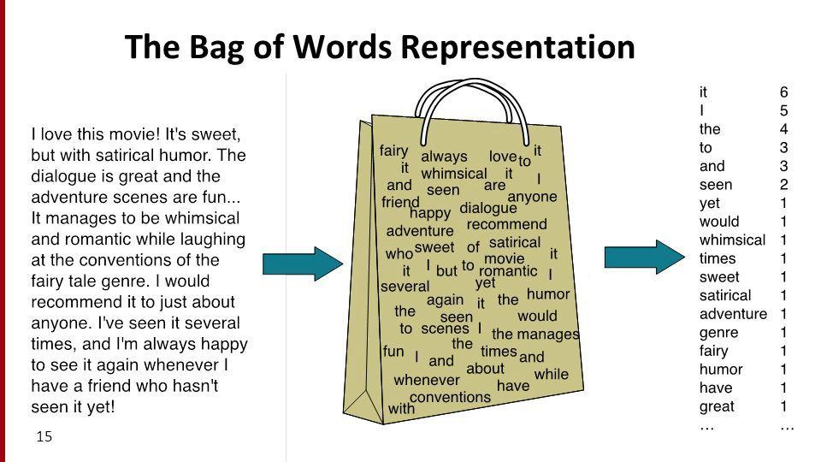

Slide 6
BoW
A more comprehensive example of the Bag of Words (BoW) model using multiple sentences and a larger vocabulary.
Example Sentences
"The cat sat on the mat."
"The dog barked at the cat."
"Cats and dogs are great pets."
"I love my cat."
"Dogs are loyal animals."

Slide 7
BoW
Step 1: Create a Vocabulary
First, we need to identify the unique words in all the sentences. The vocabulary will include all distinct words, ignoring case and punctuation.
Vocabulary:
"the"
"cat"
"sat"
"on"
"mat"
"dog"
"barked"
"at"
"and"
"dogs"
"are"
"great"
"pets"
"I"
"love"
"my"
"loyal"
"animals"

Slide 8
BoW
Vector Representation
Next, we will represent each sentence as a vector based on the vocabulary. Each position in the vector corresponds to a word in the vocabulary, and the value at that position indicates the frequency of that word in the sentence.
Vector Representation:
"The cat sat on the mat.". Vector: [2, 1, 1, 1, 1, 0, 0, 0, 0, 0, 0, 0, 0, 0, 0, 0, 0]
"The dog barked at the cat.". Vector: [2, 1, 0, 0, 0, 1, 1, 1, 0, 0, 0, 0, 0, 0, 0, 0, 0]
"Cats and dogs are great pets." Vector: [0, 0, 0, 0, 0, 1, 0, 0, 1, 1, 1, 1, 1, 0, 0, 0, 0]
"I love my cat." Vector: [0, 1, 0, 0, 0, 0, 0, 0, 0, 0, 0, 0, 0, 1, 1, 0, 0]
"Dogs are loyal animals." Vector: [0, 0, 0, 0, 0, 1, 0, 0, 0, 0, 1, 0, 0, 0, 0, 1, 1]

Slide 9
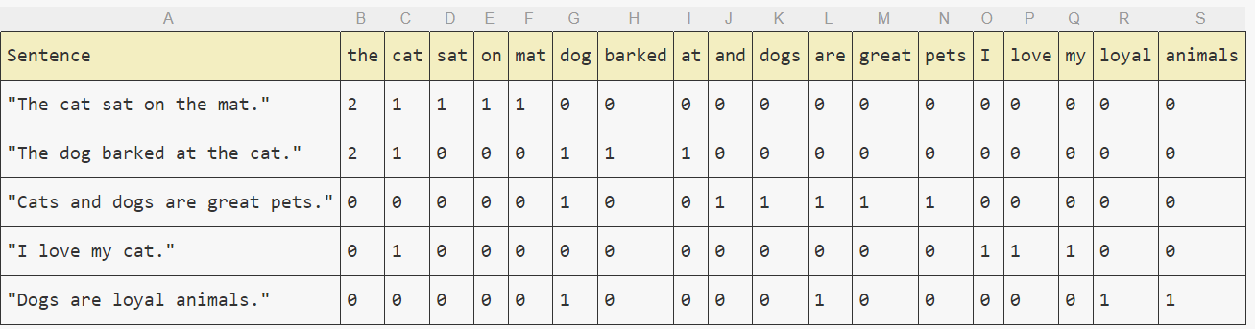
The matrix

Slide 10
Term Frequency-Inverse Document Frequency (TF-IDF)
Concept: This method not only considers the frequency of words in a document but also how common or rare they are across all documents. It helps to highlight important words.
Formula: TF-IDF = (Term Frequency) * (Inverse Document Frequency)
Use Case: It’s useful for identifying the importance of words in a document relative to a collection of documents.

Slide 11
TF IDF example
Example Documents
Let's consider the following three documents:
Document 1: "The cat sat on the mat."
Document 2: "The dog barked at the cat."
Document 3: "Cats and dogs are great pets."

Slide 12
TF IDF example
Step 1: Calculate Term Frequency (TF)
Term Frequency (TF) is the number of times a term appears in a document divided by the total number of terms in that document.
Document 1:
Total words = 7
TF for each word:
the: 2/7
cat: 1/7
sat: 1/7
on: 1/7
mat: 1/7
Document 2:
Total words = 7
TF for each word:
the: 2/7
dog: 1/7
barked: 1/7
at: 1/7
cat: 1/7
Document 3:
Total words = 6
TF for each word:
cats: 1/6
and: 1/6
dogs: 1/6
are: 1/6
great: 1/6
pets: 1/6

Slide 13
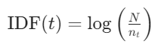
TF IDF example
Step 2: Calculate Inverse Document Frequency (IDF)
Inverse Document Frequency (IDF) measures how important a term is across all documents. It is calculated as:
Where:
N = total number of documents
Nt= number of documents containing the term t
Total documents N=3

Slide 14
Tf idf calculation
the: Appears in 2 documents → IDF = log(3/2)≈0.176
cat: Appears in 2 documents → IDF = log(3/2)≈0.176
sat: Appears in 1 document → IDF = log(3/1)≈1.099
on: Appears in 1 document → IDF = log(3/1)≈1.099
mat: Appears in 1 document → IDF = log(3/1)≈1.099
dog: Appears in 1 document → IDF = log(3/1)≈1.099
barked: Appears in 1 document → IDF = log(3/1)≈1.099
at: Appears in 1 document → IDF = log(3/1)≈1.099
cats: Appears in 1 document → IDF = log(3/1)≈1.099
and: Appears in 1 document → IDF = log(3/1)≈1.099
dogs: Appears in 1 document → IDF = log(3/1)≈1.099
are: Appears in 1 document → IDF = log(3/1)≈1.099
great: Appears in 1 document → IDF = log(3/1)≈1.099
pets: Appears in 1 document → IDF = log(3/1)≈1.099

Slide 15
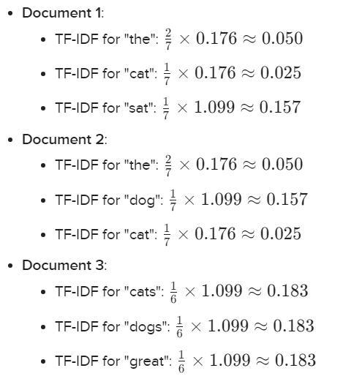
Calculate TF-IDF
Step 3: Calculate TF-IDF
Now, we can calculate the TF-IDF for each term in each document by multiplying the TF and IDF values.

Slide 16
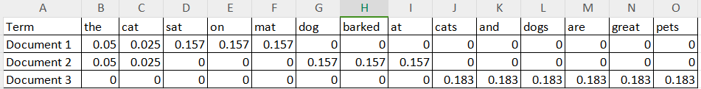
Final TF-IDF Matrix

Slide 17
N-Gram representation
N-gram representation is a technique used in natural language processing (NLP) and text analysis to break down text into smaller, contiguous sequences of items, typically words or characters. The "N" in "N-gram" refers to the number of items in each sequence.

Slide 18
Example
"I love natural language processing because it allows computers to understand human language better."
Unigrams (1-grams): ["I", "love", "natural", "language", "processing", "because", "it", "allows", "computers", "to", "understand", "human", "language", "better"]
Bigrams (2-grams): ["I love", "love natural", "natural language", "language processing", "processing because", "because it", "it allows", "allows computers", "computers to", "to understand", "understand human", "human language", "language better"]
Trigrams (3-grams): ["I love natural", "love natural language", "natural language processing", "language processing because", "processing because it", "because it allows", "it allows computers", "allows computers to", "computers to understand", "to understand human", "understand human language", "human language better"]

Slide 19
Ngram adv vs Disadvantages
Advantages:
Captures local context: N-grams can capture the context of words in a sentence, which is important for understanding meaning.
Simplicity: The concept is straightforward and easy to implement.
Disadvantages:
Sparsity: As N increases, the number of possible N-grams grows exponentially, leading to sparsity in the data.
Loss of long-range dependencies: N-grams only consider local context, which may miss relationships between words that are far apart in the text.

Slide 20
Combining N-grams with TF-IDF
When you combine N-grams with TF-IDF, you can create a more informative feature representation for text data. Here’s how it works:
Generate N-grams: First, you extract N-grams (unigrams, bigrams, trigrams, etc.) from your text documents.
Calculate TF-IDF: For each N-gram, calculate the TF-IDF score across the documents in your corpus. This will give you a numerical representation of how important each N-gram is in the context of the entire dataset.
Feature Representation: The resulting TF-IDF scores for the N-grams can be used as features in machine learning models. This representation captures both the local context (through N-grams) and the importance of terms (through TF-IDF).

Slide 21
Bigrams TF IDF example
Sentence 1: "I love natural language processing because it allows computers to understand human language better."
Sentence 2: "Natural language processing is essential for developing intelligent systems that can understand human communication."
Step 1: Extract Bigrams
From both sentences, we can extract the bigrams.
Bigrams from Sentence 1: ["I love", "love natural", "natural language", "language processing", "processing because", "because it", "it allows", "allows computers", "computers to", "to understand", "understand human", "human language", "language better"]
Bigrams from Sentence 2: ["Natural language", "language processing", "processing is", "is essential", "essential for", "for developing", "developing intelligent", "intelligent systems", "systems that", "that can", "can understand", "understand human", "human communication"]

Slide 22
Bigrams TF IDF example
Combined Bigrams
Now, let's combine the bigrams from both sentences and remove duplicates:
["I love", "love natural", "natural language", "language processing", "processing because", "because it", "it allows", "allows computers", "computers to", "to understand", "understand human", "human language", "language better", "processing is", "is essential", "essential for", "for developing", "developing intelligent", "intelligent systems", "systems that", "that can", "can understand", "understand human", "human communication"]

Slide 23
Bigrams TF
"I love": 1/23 ≈ 0.043
"love natural": 1/23 ≈ 0.043
"natural language": 2/23 ≈ 0.087
"language processing": 2/23 ≈ 0.087
"processing because": 1/23 ≈ 0.043
"because it": 1/23 ≈ 0.043
"it allows": 1/23 ≈ 0.043
"allows computers": 1/23 ≈ 0.043
"computers to": 1/23 ≈ 0.043
"to understand": 1/23 ≈ 0.043
"understand human": 2/23 ≈ 0.087
"human language": 2/23 ≈ 0.087
"language better": 1/23 ≈ 0.043
"processing is": 1/23 ≈ 0.043
"is essential": 1/23 ≈ 0.043
"essential for": 1/23 ≈ 0.043
"for developing": 1/23 ≈ 0.043
"developing intelligent": 1/23 ≈ 0.043
"intelligent systems": 1/23 ≈ 0.043
"systems that": 1/23 ≈ 0.043
"that can": 1/23 ≈ 0.043
"can understand": 1/23 ≈ 0.043
"human communication": 1/23 ≈ 0.043

Slide 24

Final matrix

Slide 25
combination of unigrams and bigrams from the two sentences
Sentence 1: "I love natural language processing because it allows computers to understand human language better."
Sentence 2: "Natural language processing is essential for developing intelligent systems that can understand human communication."
Step 1: Extract Unigrams
Unigrams from Sentence 1:
["I", "love", "natural", "language", "processing", "because", "it", "allows", "computers", "to", "understand", "human", "language", "better"]
Unigrams from Sentence 2:
["Natural", "language", "processing", "is", "essential", "for", "developing", "intelligent", "systems", "that", "can", "understand", "human", "communication"]

Slide 26
combination of unigrams and bigrams from the two sentences
Step 2: Extract Bigrams
Bigrams from Sentence 1:
["I love", "love natural", "natural language", "language processing", "processing because", "because it", "it allows", "allows computers", "computers to", "to understand", "understand human", "human language", "language better"]
Bigrams from Sentence 2:
["Natural language", "language processing", "processing is", "is essential", "essential for", "for developing", "developing intelligent", "intelligent systems", "systems that", "that can", "can understand", "understand human", "human communication"]

Slide 27
combination of unigrams and bigrams from the two sentences
Step 3: combine unigrams and bigrams
combined_list = ["I", "love", "natural", "language", "processing", "because", "it", "allows", "computers", "to", "understand", "human", "better", "is", "essential", "for", "developing", "intelligent", "systems", "that", "can", "communication", "I love", "love natural", "natural language", "language processing", "processing because", "because it", "it allows", "allows computers", "computers to", "to understand", "understand human", "human language", "language better", "processing is", "is essential", "essential for", "for developing", "developing intelligent", "intelligent systems", "systems that", "that can", "can understand", "human communication"]

Slide 28
Word Embeddings
Concept: Unlike BoW and TF-IDF, word embeddings represent words in a continuous vector space where semantically similar words are closer together. This captures more context and meaning.
Examples:
Word2Vec: Trained on large corpora to create dense vector representations of words.
GloVe: Global Vectors for Word Representation, which captures global statistical information.
Visualization: You can visualize word embeddings using techniques like t-SNE (t-distributed stochastic neighbor embedding) to show how similar words cluster together.

Slide 29
Word2Vec and GloVe
Word2Vec and GloVe (Global Vectors for Word Representation) are two popular techniques for generating word embeddings, which are dense vector representations of words that capture their meanings, relationships, and contexts.

Slide 30
Word2Vec
Word2Vec is a predictive model developed by a team led by Tomas Mikolov at Google in 2013.
It uses neural networks to learn word associations from a large corpus of text.
The main idea is to represent words in a continuous vector space where semantically similar words are located close to each other.

Slide 31
Word2Vec
Training: Word2Vec is trained on a large corpus of text using a shallow neural network. The training process involves adjusting the weights of the network to minimize the prediction error for the target and context words.
Output: The output of Word2Vec is a set of word vectors, where each word is represented as a point in a high-dimensional space (typically 100 to 300 dimensions). The distance between these points reflects the semantic similarity between the words.
Applications: Word2Vec embeddings can be used in various NLP tasks, such as sentiment analysis, text classification, and machine translation. They can also be used to find word analogies (e.g., "king" - "man" + "woman" ≈ "queen").

Slide 32
Word2Vec Architecture
Word2Vec can be implemented using two main architectures:
Continuous Bag of Words (CBOW): Predicts a target word based on its context (surrounding words).
Skip-Gram: Predicts the context words given a target word.

Slide 33
Continuous Bag of Words (CBOW)
Concept: In the CBOW model, the goal is to predict a target word based on its surrounding context words. The context is defined as a set of words that appear before and after the target word within a specified window size.
Example: Consider the sentence: "The cat sat on the mat."
Let's say we want to predict the target word "sat" using a context window of size 2. The context words for "sat" would be "The," "cat," "on," and "the."
Training Data: For the target word "sat," the training example would look like this:
Context: ["The", "cat", "on", "the"]
Target: "sat"
In a more structured format, it can be represented as:
Input: ["The", "cat", "on", "the"]
Output: "sat"
The CBOW model takes the context words as input and tries to predict the target word.

Slide 34
Skip-Gram
Concept: In the Skip-Gram model, the goal is the opposite of CBOW: it predicts the context words given a target word. This means that for a given word, the model tries to predict the words that are likely to appear in its context.
Example: Using the same sentence:
"The cat sat on the mat."
If we take the target word "sat" and use a context window of size 2, the context words would be "The," "cat," "on," and "the."
Training Data: For the target word "sat," the training examples would look like this:
Target: "sat"
Context: ["The", "cat"]
Context: ["on", "the"]
The Skip-Gram model takes the target word as input and tries to predict each of the context words.
In a more structured format, it can be represented as:
Input: "sat"
Output: "The"
Input: "sat"
Output: "cat"
Input: "sat"
Output: "on"
Input: "sat"
Output: "the"

Slide 35
Summary of Differences
CBOW: Predicts the target word from the context words. It uses the surrounding words to guess the central word.
Skip-Gram: Predicts the context words from the target word. It uses the central word to guess the surrounding words.

Slide 36
GloVe
GloVe, developed by researchers at Stanford University, is another popular method for generating word embeddings.
Unlike Word2Vec, which is a predictive model, GloVe is a count-based model that leverages global word co-occurrence statistics from a corpus.

Slide 37
GloVe
Co-occurrence Matrix: GloVe starts by constructing a co-occurrence matrix, which counts how often words appear together in a given context window. For example, if "cat" and "sat" appear together in a sentence, their co-occurrence count increases.
Probability Ratios: GloVe uses the ratios of probabilities of co-occurrence to derive word vectors. The idea is that the ratio of the probabilities of two words appearing in the same context can provide meaningful information about their relationship.
Objective Function: The GloVe model aims to find word vectors such that their dot product approximates the logarithm of the probability of their co-occurrence. The objective function is designed to minimize the difference between the predicted and actual co-occurrence probabilities.
Output: Similar to Word2Vec, GloVe produces dense vector representations for words, where the geometric relationships in the vector space reflect semantic relationships.

Slide 38
GloVe
Applications: GloVe embeddings are also used in various NLP tasks, including text classification, named entity recognition, and information retrieval. They are particularly effective in capturing global statistical information about word usage.

Slide 39
Term-document matrix
Each document is represented by a vector of words
Notes:
Imagine we have a collection of documents, such as all the works of Shakespeare. We can represent documents in such a collection by a term-document matrix, in which each row represents a word in the vocabulary and each column represents a document from the collection. Here's a small selection from a term-document matrix showing the occurrence of four words in four plays by Shakespeare. Each cell in this matrix represents the number of times a particular word (defined by the row) occurs in a particular document (defined by the column). Thus fool appeared 58 times in Twelfth Night. We can think of each column as a vector representing for a document as a point in |V |-dimensional space; thus the documents in here are points in 4-dimensional space.

Slide 40
Visualizing document vectors
Notes:
A spatial visualization of the document vectors for the four Shakespeare play documents, showing just two of the dimensions, corresponding to the words battle and fool. The comedies have high values for the fool dimension and low values for the battle dimension.

Slide 41
Vectors are the basis of information retrieval
Vectors are similar for the two comedies
But comedies are different than the other two
Comedies have more fools and wit and fewer battles.
Notes:
Two documents that are similar will tend to have similar words, and if two documents have similar words their column vectors will tend to be similar. The vectors for the comedies As You Like It [1,114,36,20] and Twelfth Night [0,80,58,15] look a lot more like each other (more fools and wit than battles) than they look like Julius Caesar [7,62,1,2] or Henry V [13,89,4,3]. A real term-document matrix, of course, wouldn’t just have 4 rows and columns, let alone 2. More generally, the term-document matrix has |V| rows (one for each word type in the vocabulary) and D columns, one for each document in the collection.

Slide 42
Idea for word meaning: Words can be vectors too!!!
battle is "the kind of word that occurs in Julius Caesar and Henry V"
fool is "the kind of word that occurs in comedies, especially Twelfth Night"
Notes:
Here's the new idea: vector semantics can also be used to represent the meaning of words. We do this by associating each word with a word vector— a row vector rather than a column vector, hence with different dimensions, as we see here. The four dimensions of the vector for fool, [36,58,1,4], correspond to the four Shakespeare plays. For documents, we saw that similar documents had similar vectors, because similar documents tend to have similar words. This same principle applies to words: similar words have similar vectors because they tend to occur in similar documents. The term-document matrix thus lets us represent the meaning of a word by the documents it tends to occur in.

Slide 43
More common: word-word matrix (or "term-context matrix")
Two words are similar in meaning if their context vectors are similar
Notes:
An alternative to using the term-document matrix to represent words as vectors of document counts, is to use the term-term matrix, also called the word-word matrix or the term-context matrix, in which the columns are labeled by words rather than documents. This matrix is thus of dimensionality |V | × |V | and each cell records the number of times the row (target) word and the column (context) word co-occur in some context in some training corpus.
The context could be the document, in which case the cell represents the number of times the two words appear in the same document. It is most common, however, to use smaller contexts, generally a window around the word, for example of 4 words to the left and 4 words to the right, in which case the cell represents the number of times (in some training corpus) the column word occurs in such a ±4 word window around the row word. For example here is one example each of some words in their windows with counts from a Wikipedia corpus. Note that digital and information are more similar to each other than, say, to strawberry.

Slide 44
Notes:
Here's a spatial visualization of word vectors for digital and information, showing just two of the dimensions, corresponding to the words data and computer.
Of course in real life these vectors aren't just of length 2. |V |, the length of the vector, is generally the size of the vocabulary, of- ten between 10,000 and 50,000 words (using the most frequent words in the training corpus; keeping words after about the most frequent 50,000 or so is generally not helpful). Since most of these numbers are zero these are sparse vector representations; there are efficient algorithms for storing and computing with sparse matrices.

Slide 45
Computing word similarity: Dot product and cosine
The dot product between two vectors is a scalar:
The dot product tends to be high when the two vectors have large values in the same dimensions
Dot product can thus be a useful similarity metric between vectors
Notes:
The cosine—like most measures for vector similarity used in NLP—is based on the dot product operator from linear algebra, also called the inner product in which we multiply the vectors elementwise and add up to get a scalar value. The dot product acts as a similarity metric because it will tend to be high just when the two vectors have large values in the same dimensions. Alternatively, vectors that have zeros in different dimensions—orthogonal vectors—will have a dot product of 0, representing their strong dissimilarity.

Slide 46
Problem with raw dot-product
Dot product favors long vectors
Dot product is higher if a vector is longer (has higher values in many dimension)
Vector length:
Frequent words (of, the, you) have long vectors (since they occur many times with other words).
So dot product overly favors frequent words
Notes:
This raw dot product, however, has a problem as a similarity metric: it favors long vectors. The vector length is defined as the square root of the sum of the square of the values
The dot product is higher if a vector is longer, with higher values in each dimension. More frequent words have longer vectors, since they tend to co-occur with more words and have higher co-occurrence values with each of them. The raw dot product thus will be higher for frequent words. But this is a problem; we’d like a similarity metric that tells us how similar two words are regardless of their frequency.

Slide 47
Alternative: cosine for computing word similarity
Based on the definition of the dot product between two vectors a and b
Notes:
We modify the dot product to normalize for the vector length by dividing the dot product by the lengths of each of the two vectors. This normalized dot product turns out to be the same as the cosine of the angle between the two vectors (Geometrically, it is the product of the Euclidean magnitudes of the two vectors and the cosine of the angle between them).

Slide 48
Cosine examples
 | pie | data | computer
cherry | 442 | 8 | 2
digital | 5 | 1683 | 1670
information | 5 | 3982 | 3325
Notes:
Let’s see how the cosine computes which of the words cherry or digital is closer in meaning to information, just using raw counts from the following shortened table.
The model decides that information is way closer to digital than it is to cherry, a result that seems sensible.

Slide 49


QA
Thanks … Grazie … شكرا … Gracias … Merci … 谢谢 (Xièxiè)

